Slide 1
Control flow statement
UNIT - 3

Slide 2
Conditional Expression
A conditional statement as the name suggests itself, is used to handle conditions in your program. These statements guide the program while making decisions based on the conditions encountered by the program.
The if statement is a conditional statement in python, that is used to determine whether a block of code will be executed or not. Meaning if the program finds the condition defined in the if statement to be true, it will go ahead and execute the code block inside the if statement.

Slide 3
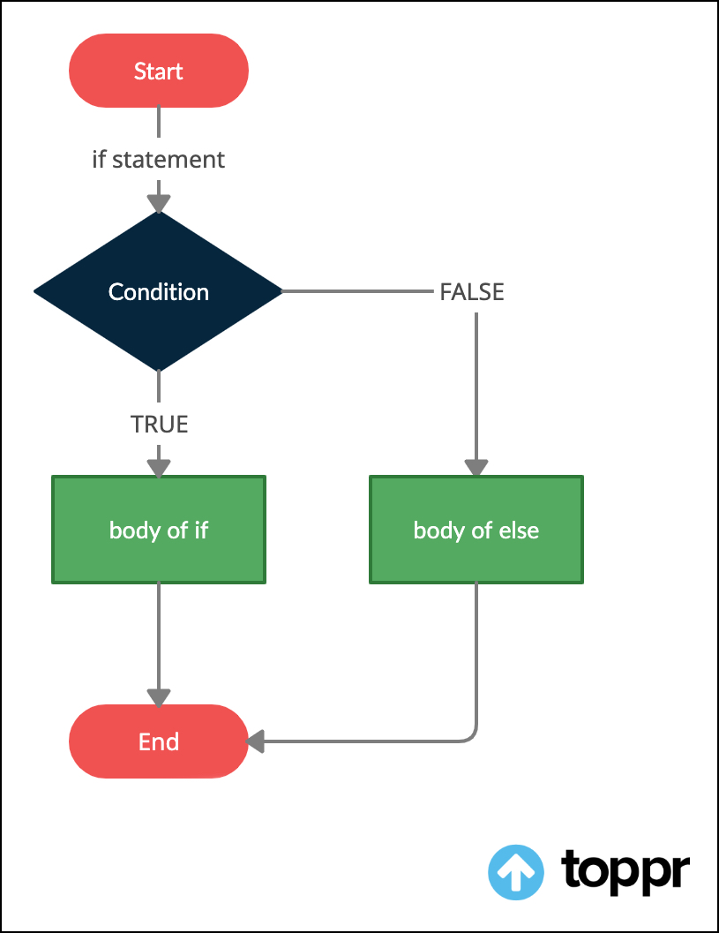
Flow chart of if-else statement

Slide 4
Syntax of if-else
if condition:
# execute code if condition is true
else:
#execute code if condition if False
Ex=>
a=5
b=7
If (a>b):
print(“a is greater”)
Else:
print(“b is grater”)
Note: if statement can also be used without the else part of the code.

Slide 5
if-elif-else ladder:
The elif keyword is Python's way of saying "if the previous conditions were not true, then try this condition".
Syntax->
if condition1:
# code block 1
elif condition2:
# code block 2
else:
# code block 3

Slide 6
Example of if-elif-else ladder:
number = int(input(“enter any number”))
if number > 0:
print("Positive number")
elif number == 0:
print('Zero')
else:
print('Negative number')
print('This statement is always executed')

Slide 7
Nested conditional statement
We can also use an if statement inside of an if statement. This is known as a nested if statement.
Syntax=>
# outer if statement
if condition1:
# statement(s)
# inner if statement
If condition2:
# statement(s)

Slide 8
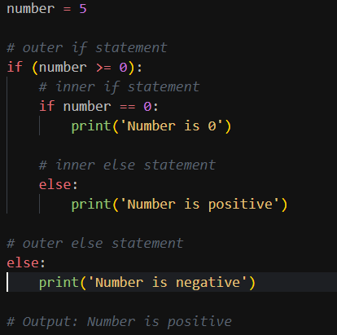
Example of nested if-else

Slide 9
Loops
Looping means repeating something over and over until a particular condition is satisfied. A for loop in Python is a control flow statement that is used to repeatedly execute a group of statements as long as the condition is satisfied
In Python we have 2 type of looping: statement:
While loop
For loop

Slide 10
While loop
In python, a while loop is used to execute a block of statements repeatedly until a given condition is satisfied. And when the condition becomes false, the line immediately after the loop in the program is executed
Many a times when increment or decrement value is not given in while loop, it stuck in an infinite loop. i.e. same output infinite times.
Syntax:
while expression:
statement(s)

Slide 11
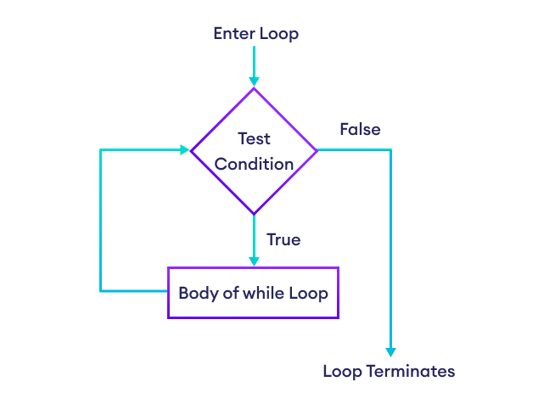
Flow chart of while loop

Slide 12
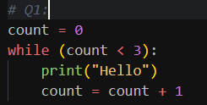

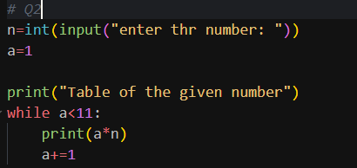
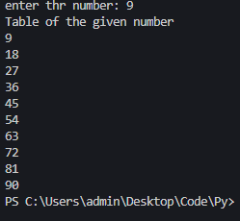
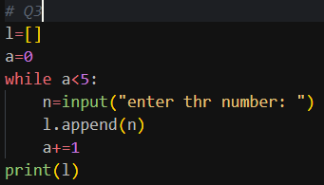
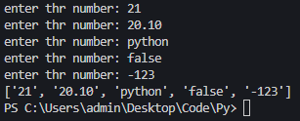
While loop example
Output:
Output:
Output:

Slide 13
For loop
A for loop is used for iterating over a sequence
(that is either a list, a tuple, a dictionary, a set, or a string).
This is less like the for keyword in other programming languages, and works more like an iterater method as found in other object-orientated programming languages.
Range function in python is used to generate a sequence of numbers.
We can also specify the start, stop, skip value
eg:- range(1,10,2) here 1 is start value (default value 0)
10 is stop value (need to be specified)
2 is skip value (default value 1)
Syntax:
for variable in sequence:
# statement(s)

Slide 14
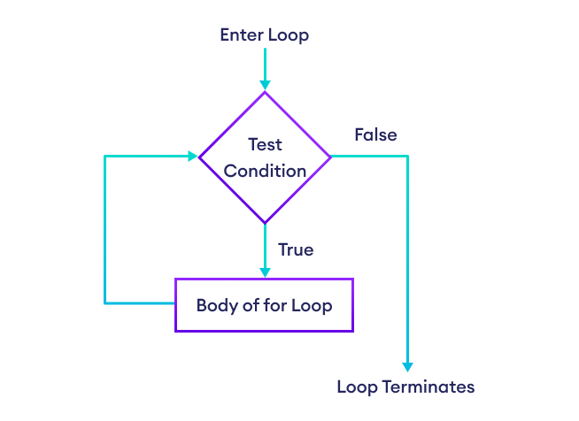
Flow chart of For loop
(*same as while loop)

Slide 15
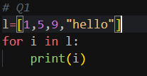

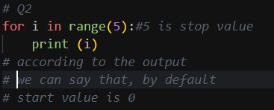
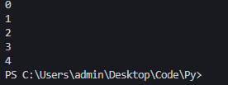
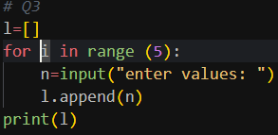
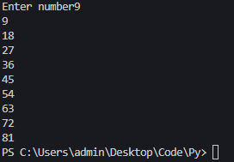
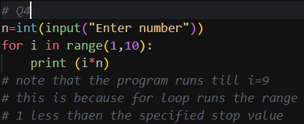
For loop example
Output:
Output:
Output:
Output:

Slide 16
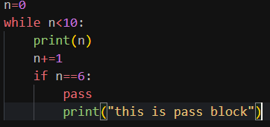
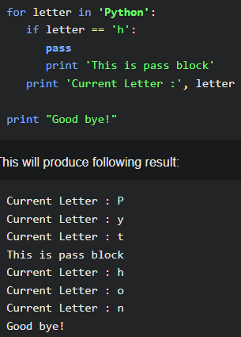
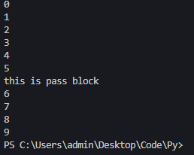
Loop manipulation
Pass statement:-
While Loop: Q) Output:
For Loop: Q) Output:

Slide 17
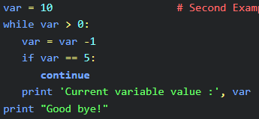
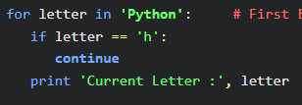
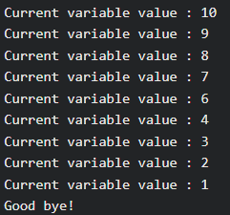
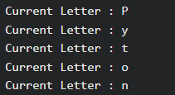
Loop manipulation
Continue statement:-
While Loop: Q) Output:
For Loop: Q) Output:

Slide 18
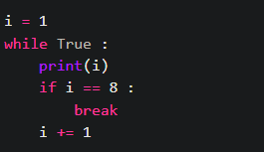


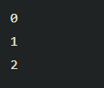
Loop manipulation
Break statement:-
While Loop: Q)
For Loop: Q)
Output:
Output:

Slide 19
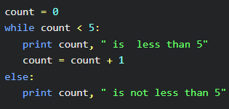

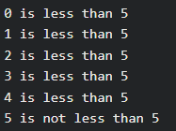

Loop manipulation
Else statement:-
While Loop: Q) Output:
For Loop: Q) Output:

